Slide 1
Benjamin Greer and Family
Anthony Benson
UCO 1200: Appalachian and American Family Stories
Perry

Slide 2
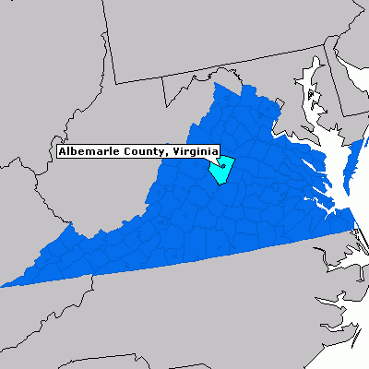
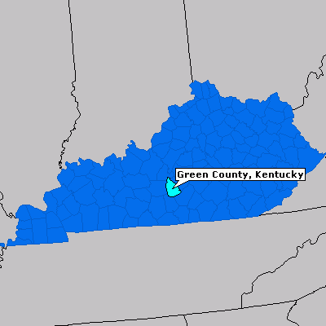
Biological Background
Birth
Death
February 9th, 1746
October 23rd, 1816

Slide 3
Marriage and Children
Children: The children of Benjamin Greer and Nancy Wilcoxson;
Rachel Greer (3/31/1768 – 1840)
John Greer (1/14/1770 – 1850)
William Greer (1/21/1772 – 1862)
Benjamin Greer Jr. (2/14/1774 – Aft. 1800)
Nancy Ann Greer (4/26/1776 – Death Unknown)
Jesse Greer Sr. (11/14/1778 – 9/17/1869)
David Greer (My family’s ancestor) (2/2/1781 – 1850)
James Greer (9/17/1783 – 1844)
Samuel Greer (11/25/1785 – 4/20/1872)
Joshua Greer (4/8/1788 – 1860)
Thomas Greer (10/3/1790 – Death Unknown)
Marriage:
Nancy Wilcoxson (first wife)
Sarah Atkinson (second wife)
*Information on the children of Benjamin and Sarah Atkinson was not found.*

Slide 4
Benjamin Greer’s Migration Patterns
1st Migration: Albemarle Co, VA to Wilkes Co, NC in 1760’s.
2nd Migration: Wilkes Co to “Old Fields”, Ashe Co in 1780’s
3rd Migration: Ashe Co, NC to Green County KY after second marriage.

Slide 5
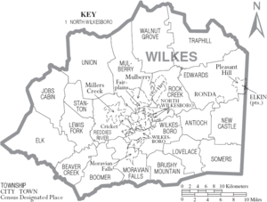
Helping to Build a County; The Wilkes Years
History of Wilkes
Indian Occupation
Area settled by the Moravians in 1752.
Daniel Boone’s Home
1777 NC Assembly
Battle at King’s Mtn.

Slide 6
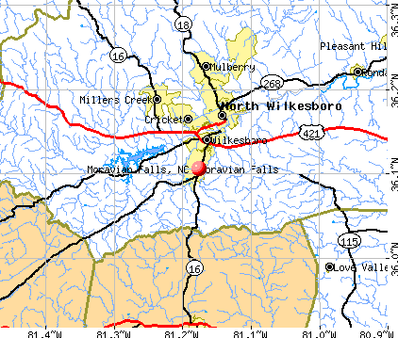
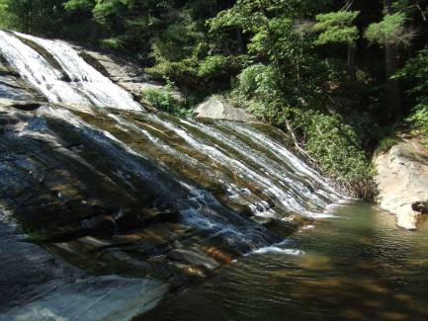
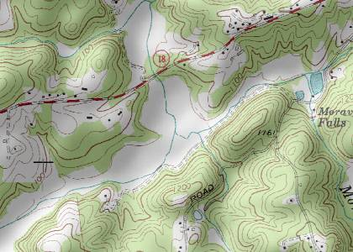
Constable Greer

Slide 7
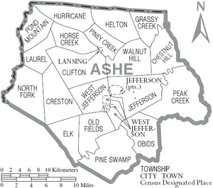
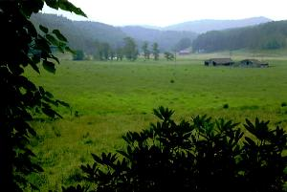
Life in Ashe County
Moved to Ashe Co in the 1780’s.
Settled in “Old Fields”.
Early Ashe Co living…
Notes:
lljfalkfjakljfalsjfsljslkdjf

Slide 8
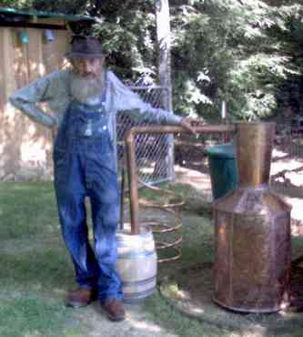
Church Go’er
Three Forks Baptist Church
Left church in 1801 due to intemperance.

Slide 9
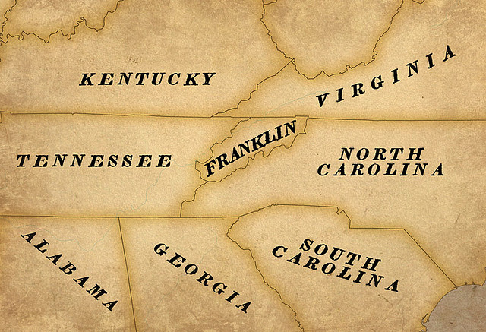
The State of Who?

Slide 10
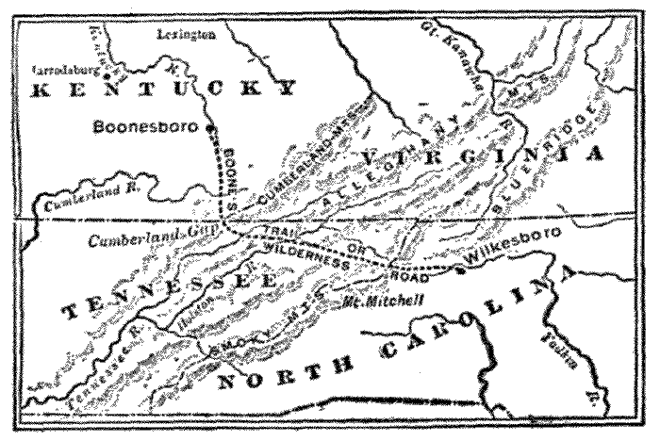
Kentucky
Bound
_______________________________
2nd Marriage
Moved to Green Co, KY
Daniel Boone’s Wilderness Road
2nd Marriage
and a Move

Slide 11
The Final Days
Remained in Green Co, KY
Last Will and Testament
Death: October 23, 1816

Slide 12
Primary Sources
Adams, Myrtle. Interview by Benson, Anthony. Personal interview. 155 Curly Rd, Taylorsville, NC, 28681, April 3, 2012.
"Genealogy, Family Trees & Family History Records at Ancestry.com." Genealogy, Family Trees & Family History Records at Ancestry.com. http://www.ancestry.com/cgi-bin/sse.dll?rank=1&new=1&MSAV=0&msT=1&gss=angs-g&gsfn=benjamin&gsln=greer&mswpn__ftp=Wilkes+County%2c+North+Carolina%2c+USA&mswpn=3154&mswpn_PInfo=7-%7c0%7c1652393% (accessed March 16, 2012).
"The Greers and Related Familes of North Carolina:Information about Benjamin Greer." Genealogy.com - Family Tree Maker Family History Software and Historical Records. http://familytreemaker.genealogy.com/users/g/a/y/Deborah-Gaynor/WEBSITE-0001/UHP-0176.html (accessed March 4, 2012).
1787 census, Wilkes County, North Carolina. North Wilkesboro, N.C.: Wilkes Genealogical Society
"Albemarle County, Virginia County Information - ePodunk." City & County Information, Town & Community Information - ePodunk. http://www.epodunk.com/cgi-bin/genInfo.php?locIndex=22874 (accessed March 27, 2012).
"Appalachian crafts, farming, making moonshine, and mountain folk lore.." Cast Iron Cookware, Country Ham, Folk Art,& Crafts of the Smoky Mountains. http://www.apptrav.com/howto.html (accessed March 30, 2012).
Burchette, Linda. "Mountain Beautiful." Mountain Beautiful. http://mountainsandmountains.blogspot.com/ (accessed April 13, 2012).
Eubank, R. S., and A. B.. "The Project Gutenberg EBook of The story of Kentucky by Rice S. Eubank." Project Gutenberg - free ebooks. http://www.gutenberg.org/files/28239/28239-h/28239-h.html (accessed April 23, 2012).

Slide 13
"Green County, Kentucky County Information - ePodunk." City & County Information, Town & Community Information - ePodunk. http://www.epodunk.com/cgi-bin/genInfo.php?locIndex=4006 (accessed March 27, 2012).
"JOHN SHEPHERD, JR. - The Ancestry of Grover and Harrison Shepherd by Brodrick Shepherd." BEASTS, HORNS AND THE ANTICHRIST: Daniel A Blueprint of the Last Days?.
http://www.danielprophecy.com/johnjr.html (accessed April 13, 2012).
Lazy Bear Lodge - Blue Ridge Parkway accessible Bed and Breakfast | Area Waterfalls | NC Bed and Breakfast | Mountain Getaway." Untitled Page. http://www.lazy-bear-lodge.com/WaterfallGallery.aspx (accessed March 27, 2012).
"Moravian Falls, North Carolina (NC 28654) profile: population, maps, real estate, averages, homes, statistics, relocation, travel, jobs, hospitals, schools, crime, moving, houses, news, sex offenders." Stats about all US cities - realestate, relocation info, crime, house prices, cost of living, races, home value estimator, recent sales, income, photos, schools, maps, weather, neighborhoods, and more. http://www.city-data.com/city/Moravian-Falls-North-Carolina.html (accessed March 27, 2012).
"West Prong Moravian Creek USGS Moravian Falls Quad, North Carolina, Topographic Map." Topographic Maps & Aerial Photos for United States & Canada. http://www.topozone.com/map.asp?lon=- 81.1992522&lat=36.0854092&datum=nad83 (accessed March 27, 2012).
"Wilkes County, North Carolina - Wikipedia, the free encyclopedia." Wikipedia, the free encyclopedia. http://en.wikipedia.org/wiki/Wilkes_County,_North_Carolina (accessed March 30, 2012).

Slide 14
Secondary Sources
Hartley, Cecil B. 1902. The life of Daniel Boone, the founder of the state of Kentucky. New York: Burt.
Hayes, Johnson J.. The land of Wilkes. Wilkesboro’s County Historical Society, 1962.
"intemperance - definition of intemperance by the Free Online Dictionary, Thesaurus and Encyclopedia.." Dictionary, Encyclopedia and Thesaurus - The Free Dictionary. http://www.thefreedictionary.com/intemperance (accessed April 12, 2012).
N.C.: WilkeAbsher, W. O.. Wilkes County court minutes. Easley, S.C.: Southern Historical Press, 1988.
Waugh, Betty Linney. The Upper Yadkin Valley in the American Revolution: Benjamin Cleveland, Symbol of Continuity. Wilkesboro, N.C.:s.n., 1971.
Williams, Samuel Cole. History of the lost state of Franklin. Rev. ed. Philadelphia: Porcupine Press, 1974.

