Slide 1
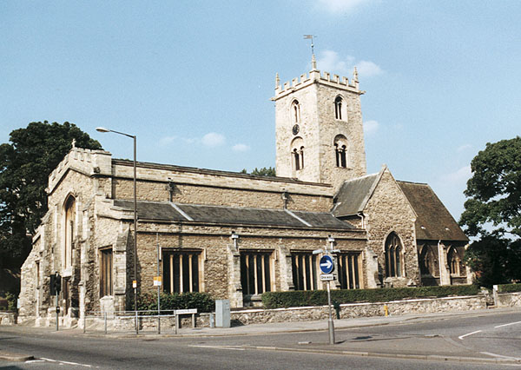
THE HOLYMAN FAMILY FROM ENGLAND TO VIRGINIA The Parish of St. Mary’s, Bedford, Bedfordshire where Christopher Holyman was baptized in 1618
Notes:
The Parish of St. Mary’s, Bedford, Bedfordshire where Christopher Holyman was baptized in 1618. Christopher was born in 1618 and died in 1691 at his plantation, Mill Swamp, Isle of Wight, Virginia. His sister, Judith, who made the trip to Virginia, was born in 1621.

Slide 2
Notes:
Find London on the map, and move approximately 35 miles gently north and east to our 15th century Holyman sites.

Slide 3
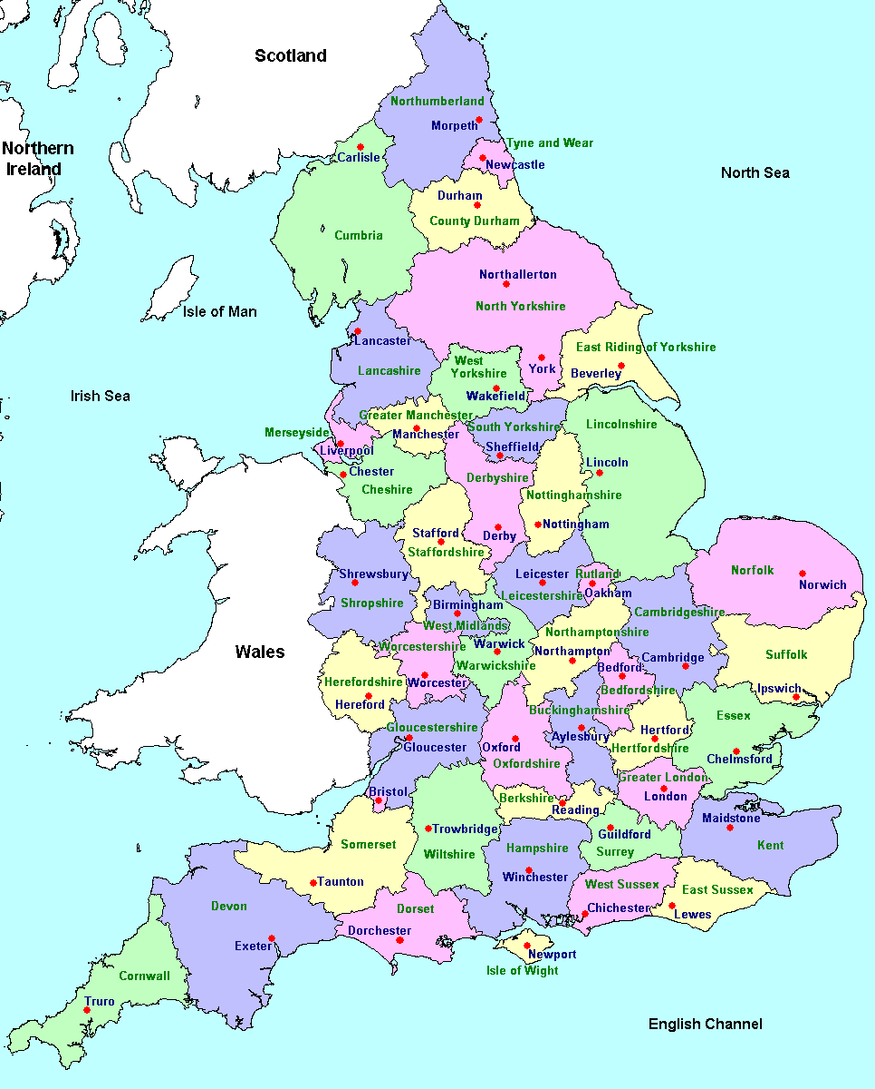
Notes:
Note Aylesbury in Buckinghamshire. Just northeast is Bedford, Bedfordshire. These are ancestral locations of Christopher Holyman (1618-1691) who immigrated to Virginia in 1650.

Slide 4
Notes:
Here is a close up of Aylesbury and Bedford. Holliman names can be found today in Worcester, Buckinghamshire, Bedfordshire and Hertfordshire.

Slide 5
Holyman Ancestral Sites in England
Notes:
The first Holyman name to appear in history from which I believe we are descended was one Richard Holiman, a member of Parliament from Buckinghamshire in 1386 during the reign of Richard II. That was the decade in which Chaucer wrote Canterbury Tales who also joined Parliament that session with Richard. Our Parliamentarian ancestor was from Chipping Wycombe, now called High Wycombe. The lower X is Cuddington, Buckinghamshire where our known great grandparents lived in the 1400 and 1500s. The upper X is Sherington, Bucks. where Christopher and Margaret Lee Holyman lived in the 1580s. Thomas Holyman was born and educated here, before moving to Bedford. There he worked as a cord wainer and leased the Blue Boar Inn for over 20 years. Christopher Holyman, b 1618, was born there.

Slide 6
A Holyman Family Lineage
Richard Holyman (1345) Chipping Wycombe, Richard Holyman (1379) Haddenham, and Richard Holyman (1386), Chipping Wycome, Buckinghamshire and John Holyman (1495), Cuddington, Buckinghamshire , England*
John Holyman (d 1521), Cuddington, Buckinghamshire, England
John Holyman (d 1533), Cuddington, Buckinghamshire, England
Thomas Holyman (1500 ca – 1558), Cuddington, Buckinghamshire, England
Christopher Holyman (1545 ca – 1588), Sherington, Buckinghamshire, England
Thomas Holyman (1580 ca – 1648/53 ca), Bedford, Bedfordshire, England
Christopher Holyman (1618-1691), Isle of Wight County, Virginia
Notes:
“The paternal fore bearer of the Holliman name came from England in the mid-1600s. Therefore, we American Hollimans share in the complexity of our British heritage. We are composed of Neolithic, Celtic, Roman, Angle, Saxon, Jute, Danish, Viking and French Norman DNA. Mix this together, stir for several thousand years and one becomes British. Sail to the New World, add yet more cultures and races, plus several hundred additional years and one becomes an American.” – Glenn N. Holliman 2012
* Indicates speculation only

Slide 7
Cuddington, England Holyman Home 1400s to 1900
Notes:
The name Holliman (or Holyman, Hollyman, Holleman, Holleman, etc) is English. While possibly of London or Kent origin, after surnames began to be used extensively in the 13th Century, persons with the name of Holyman could be found by the 1400s and 1500s in records in Nottinghamshire, Worcestershire, Hertfordshire and Buckinghamshire.
The first Holyman name to appear in history from which I believe we are descended was one Richard Holiman, a member of Parliament from Buckinghamshire in 1386 during the reign of Richard II. That was the decade in which Chaucer wrote Canterbury Tales who also joined Parliament that session with Richard. Our Parliamentarian ancestor was from Chipping Wycombe, now called High Wycombe. The city is located at an M-40 exit some 30 miles from central London, a 20th Century super highway that connects the capitol city with Birmingham.

Slide 8
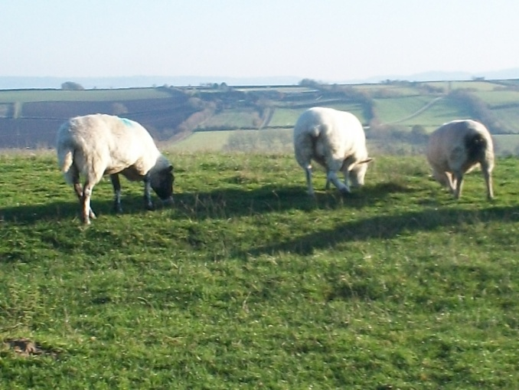
Site of 1500s Holyman Manor House Glenn Holliman and Jeanette Holiman Steward, Cuddington, Buckinghamshire, England, August 2013
Notes:
Glenn Holliman and Jeanette Holiman Stewart stand on location of original Holyman manor house. The sheep graze on a nearby hill overlooking the Cuddington valley in Buckinghamshire. These first Holymans were on the rise economically and socially. Richard Holyman had been a member of Parliament. What happened to the family between this date and our next listing of Holymans, I have not yet fully explored. The family was no doubt multiplying as several Holyman branches in Cuddington are recorded at the beginning the 16th Century.

Slide 9
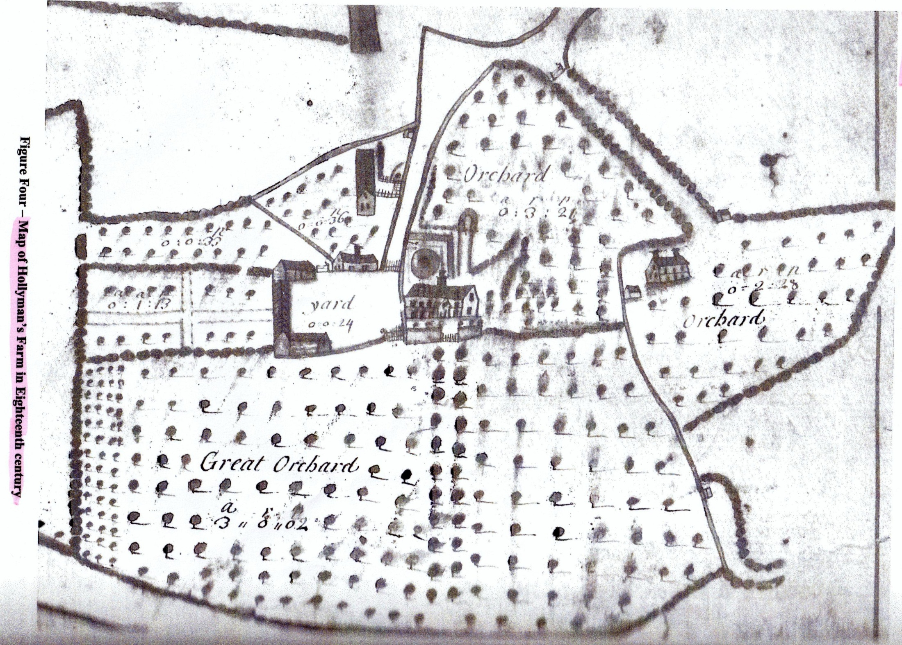
The Holyman Manor
Notes:
The Holyman Farm in Cuddington in the 1700s.

Slide 10
Holyman House, Cuddington, Buckinghamshire 1699
Notes:
This thatched home stands on the grounds of the Holyman manor home and farm of the 15th and 16th centuries. Until the 1980s, this had remained a working farm. Since the late 1980s, the Caroline Stonham family has renewed and modernized the Holyman House without sacrificing its history and much of its interior.

Slide 11
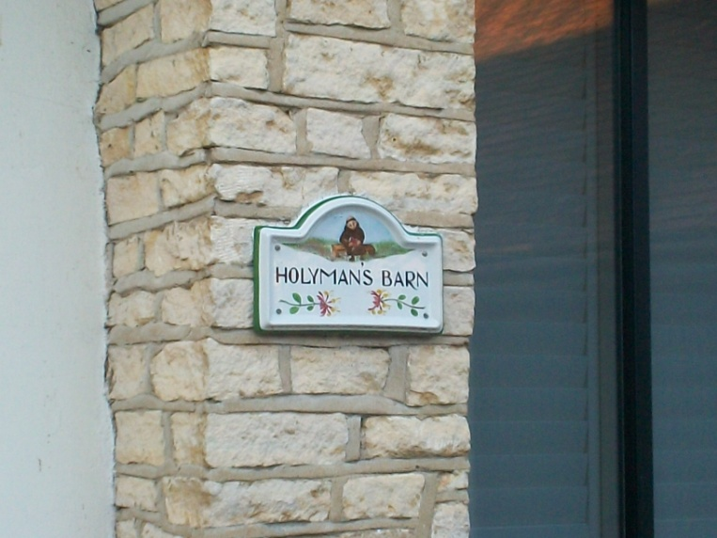
Holyman Farm Restoration Cuddington, Buckinghamshire
Notes:
This sign is on the renovated mews of the Holyman Farm in Cuddington, Buckinghamshire, England. The monk represents The Rt. Rev. John Holyman (1495-1558) who was a Roman Catholic brother before becoming Bishop of Bristol, England, 1554-1558.

Slide 12
St. Nicholas Parish, Cuddington, Buckinghamshire
Notes:
In this cemetery and possibly in the nave, lie in the dust of John Holyman (d 1521) and his son, John (d 1533), Thomas (d 1558), his wife Dorothy Clark and many more Holymans, direct ancestors of the Hollimans in America today. Dorothy’s father was named Christopher, and that name was given to Christopher Holyman (d 1588) who married Margaret Lee of Dinton and moved to Sherington, Buckinghamshire.

Slide 13
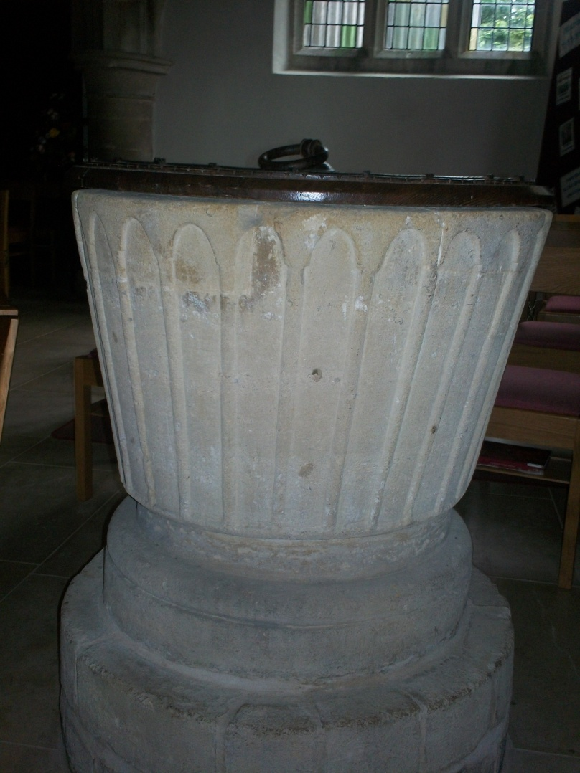
The 13th Century Baptismal Font of St. Nicholas Parish
Notes:
Holymans were baptized from this font for hundreds of years in Cuddington, Buckinghamshire.

Slide 14
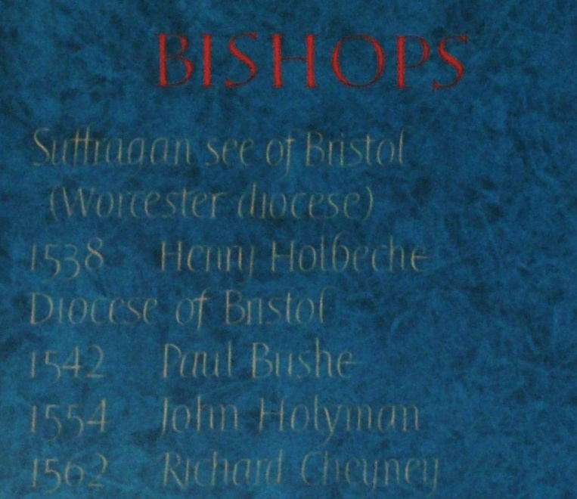
The Rt. Rev. John Holyman (1495-1558) Bishop of Bristol, England during the Reign of Queen Mary Tudor 1554-1558
Notes:
Baptized in Cuddington in 1495, The Rt. Rev. John Holyman studied at Oxford, was a monk at Reading, preached against Henry VIII’s divorce and remarriage, and was ‘exiled’ to a parish church in Ireland for a time. Later pastor at Long Hanborough and served on the commission that found Archbishop Cranmer guilty of heresy. After Cranmer burned at the stake, appointed Bishop of Bristol during Reign of Mary Tutor (Bloody Mary) and sent five Protestants to be burned. Mercifully died of natural causes one month after Queen Mary. He was a brother of either John or Thomas Holyman of Cuddington.

Slide 15
St Peter and St Paul, Long Hanborough, Oxfordshire
Notes:
The Rt. Rev. John Holyman, former rector of this parish and Bishop of Bristol (1854-1558) and brother of one of our direct great grandfathers, lies buried in the church itself. Long Hanborough is only five miles from Blandon, where lies buried the greatest Englishman of the 20th Century, Winston S. Churchill.

Slide 16
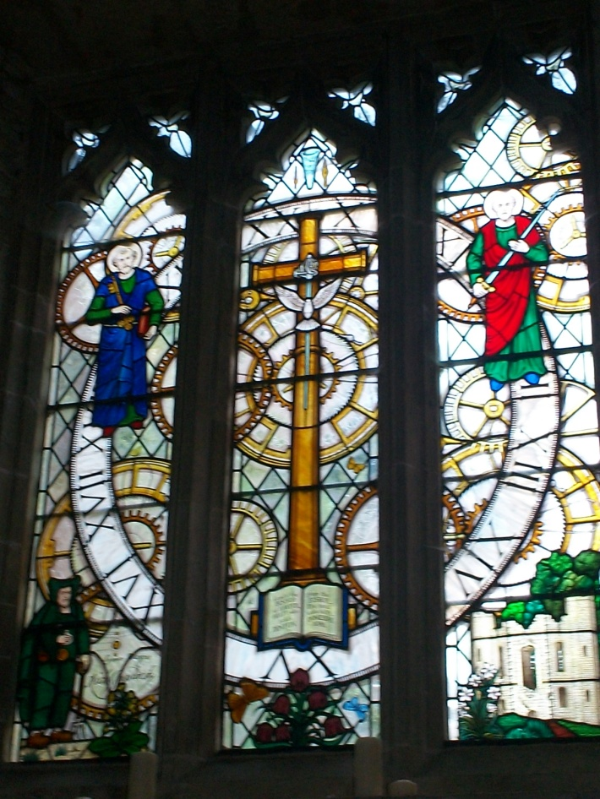
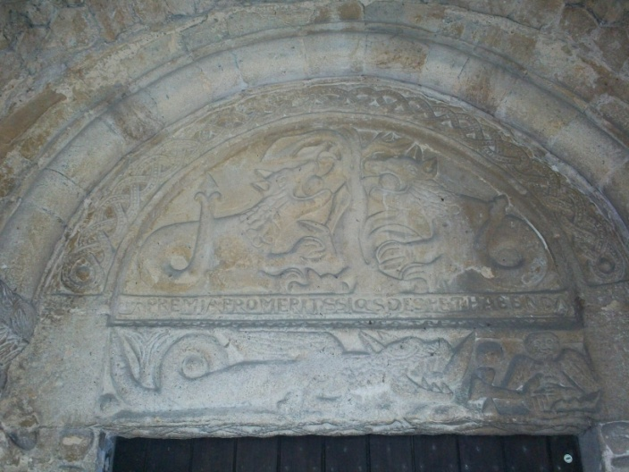
St Peter and St Paul, Dinton, Buckinghamshire, England
Notes:
Where Christopher Holyman and Margaret Lee probably married ca 1570. Dinton is located only 3 miles from Cuddington. Both the Lees and Holymans were socially prominent in the middle 1500s. The Lees continued to rise politically. Christopher, not the first born son, inherited no land. His second son, Thomas, inherited no land. Thomas’ second son, Christopher Holyman (b 1618) migrated to Virginia in 1650 and died in 1691 owning 1,020 acres. Part of this acreage remains in the Holleman family to this day.

Slide 17
The Brass Memorials of the Lee Family
Notes:
George Lamb, curator points out brass memorials for Lee families at St Peter and St Paul, Dinton, Buckinghamshire, England. These celebrate the lives of Margaret Lee’s brother Thomas and his wife, and her grandparents.

Slide 18
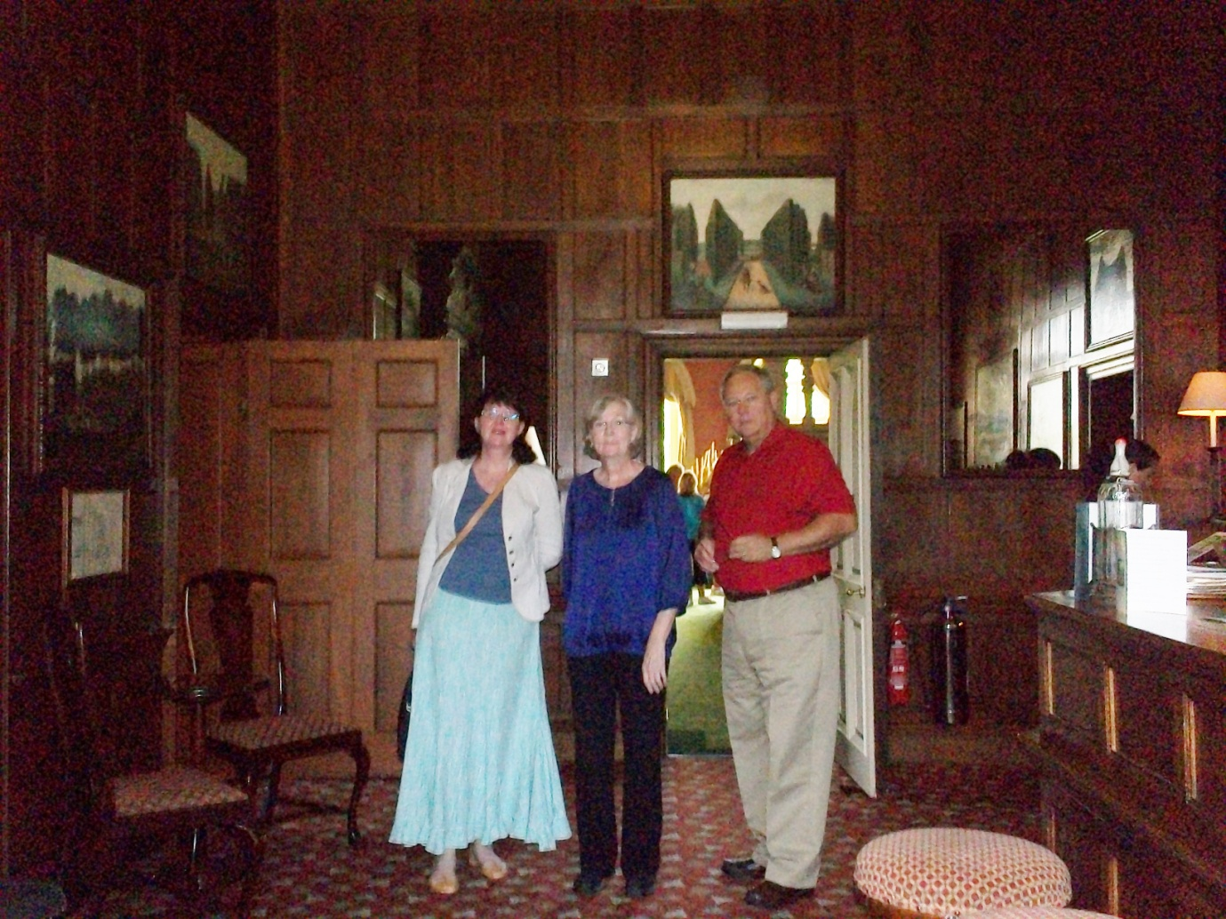
Hartwell House, Aylesbury, Buckinghamshire, 17th Century Home of the Lees
Notes:
The Lees continued to rise through marriages and politics. By the early 1600s, the Lees had moved to Hartwell House in Stone, near Aylesbury, Buckinghamshire. Hartwell House today is on the National Trust, one of three historic hotels in England. Above Anne Holmes, professional genealogist from England, Jeanette Holiman Stewart and Glenn Holliman, descendants of the Lees and Holymans in the hotel.

Slide 19
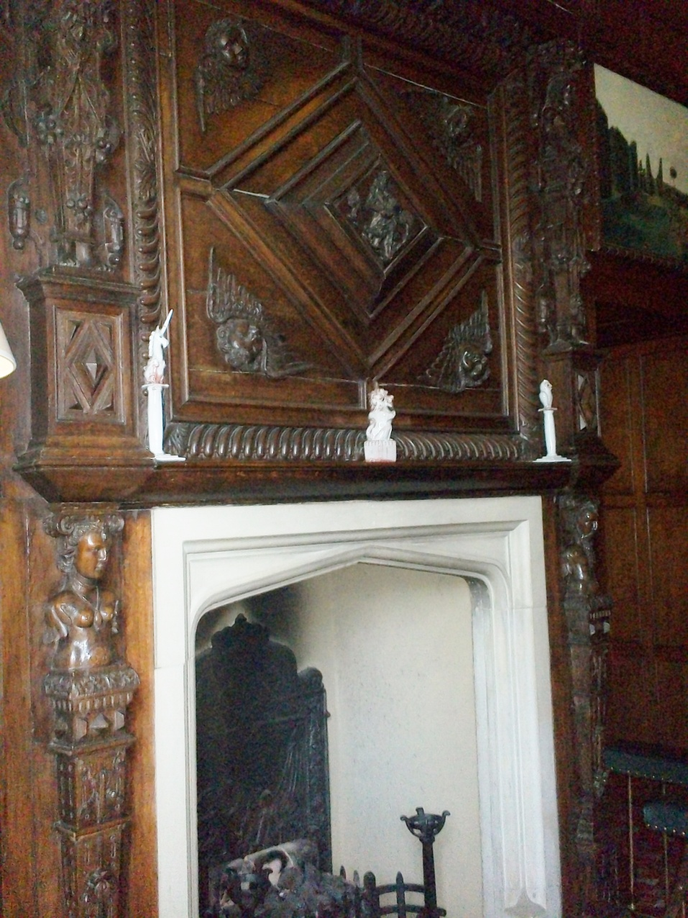
Hartwell House Interiors
Notes:
The opulence of the Hartwell House reflects the affluence of the Lee families from previous centuries. Alas, Thomas Holyman (1580 ca – 1650 ca) ran an inn and made shoes to support his large family during the Depression of the 1620s in England.

Slide 20
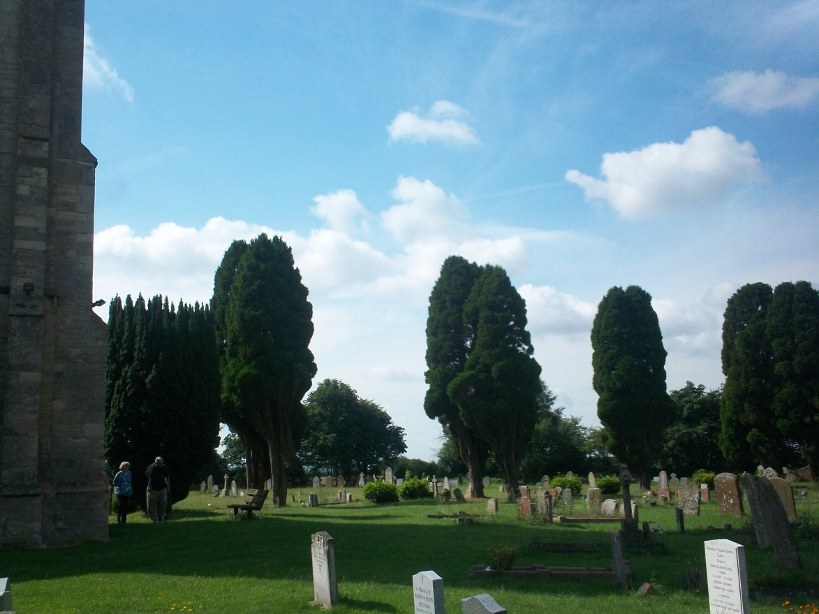
St Laud, Sherington, Buckinghamshire
Notes:
Parish home of Christopher Holyman where in the 1580s, Christopher and another prominent gentleman, went to the bishop and had the vicar dismissed. Christopher and his wife, Margaret Lee Holyman, may be buried here in Sherington, Buckinghamshire, only 12 miles from Bedford, Bedfordshire.

Slide 21
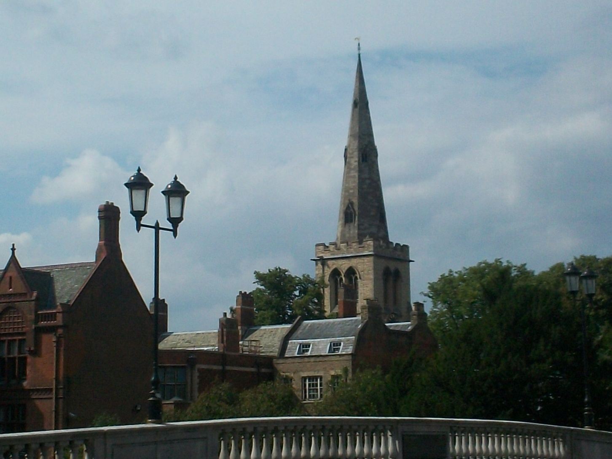
St Peters, Bedford, Bedfordshire where Thomas Holyman married
Notes:
From Sherington, Christopher’s son Thomas, migrated the 10 miles or so to Bedford and there began a career running the Blue Boar Inn and as a leather maker. He married Helen Poynard in 1608 in St. Peters on the north side of the Great Ouse River.

Slide 22
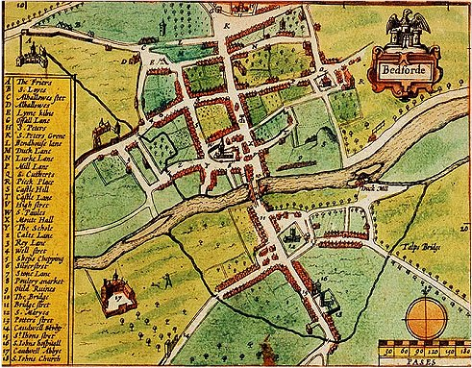
8 Caldwell Street, Bedford, Bedfordshire, England, site of the Blue Boar Inn
Notes:
Burial records state Eleanor Holyman was buried in the church yard in 1653 of St. Mary’s above, a person believed to be the wife of Thomas. Here Jeanette Holiman Stewart stands at the site where Christopher Holyman was born and must have worked in his father’s inn and leather shop while growing up. At age 32, Christopher and sister Judith migrated to Jamestown, Virginia.
Thomas and Eleanor’s second son was named Christopher and born in 1618. In my opinion this is the Christopher Holyman (1618-1691) who arrived in Jamestown, Virginia in 1650 with his sister, Judith, born 1621, also in Bedford and baptized at St. Mary’s parish astride the Great Ouse River.

Slide 23
A Cord Wainer’s 17th Century Shoe
Notes:
In 2013, Jeanette Holiman Stewart and Glenn Holliman visited the Albion Archeology Centre located in the old parish of St. Mary’s where Holymans worshipped and are buried. Here they examine a 17th century child’s shoe rescued from a dig in Bedford. Thomas Holyman may have made shoes such as these in the early 1600s to support his large family.

Slide 24
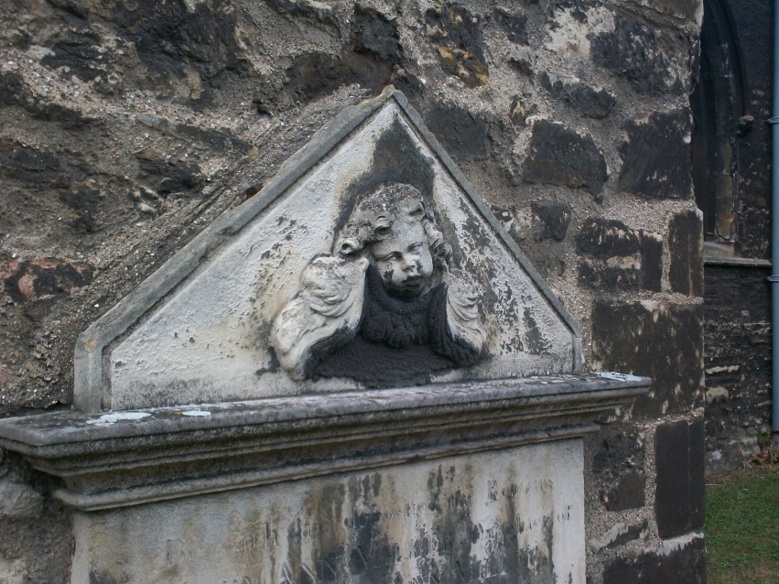
The Cemetery at St. Mary’s, Bedford, Bedfordshire, England
Notes:
Over the last 1,000 years over 80,000 English have been buried in St. Mary’s parish. In these grounds lies the dust of Holymans.

Slide 25
The Thirteen English Colonies
Notes:
The map shows the various British and European settlements along the East Coast of what is now the United States. Notice the Cherokee and Creek nations in what are now Alabama, Georgia and Tennessee.

Slide 26
1650 Colonial Settlements
Notes:
In 1650, brother and sister, Christopher and Judith Holyman, arrived in Jamestown, Virginia and joined perhaps 40,000 other British and some West Africans in the Chesapeake Bay colonies. Notice even by 1700, there has been little increase in pioneers pushing further west.

Slide 27
Holyman Virginia Settlements, 1650 – 1691
Notes:
Christopher and his sister Judith Holyman arrived in 1650 in Jamestown, Virginia. By 1661, Christopher owned land near what is now Smithfield along the Cypress River. By the 1680s, he had patented property along the Blackwater River in an area called Mill Swamp (X marks the spot), Isle of Wight County. He died there in 1691 and is in unmarked grave. The Holleman family still owns a portion of the original plantation.
Christopher had two daughters who married Atkinsons and four sons. Descendants of the sons remain in the area today, and others joined in the western march, generally through the Carolinas (but not always) and some arriving in Texas prior to the Civil War. Even day, despite the diaspora of the 20th Century, Hollimans and associated names, still live largely in the southeast and southwest United States.

Slide 28
Isle of Wight County, Virginia 1607-1865
Notes:
In the upper right hand corner of Isle of Wight County, just under the words ‘Surry County’ is situation the Holleman House, originally a plantation of 1,020 acres in 1691. The original property bordered the Blackwater River and the Mill Swamp. Many Holymans moved just north into Surry County in the 18th century. The Hollemans helped found the Mill Swamp Baptist Church, one of if not the first Baptist church in Virginia. The family in the 19th century gave the property for the cemetery that lies adjacent to the church.

Slide 29
1980s View of Holleman Plantation Mill Swamp, Isle of Wight County, Virginia
Notes:
This aerial view captures the 1830 Holleman House and out buildings. Christopher Holyman may be buried on or near this location.

Slide 30
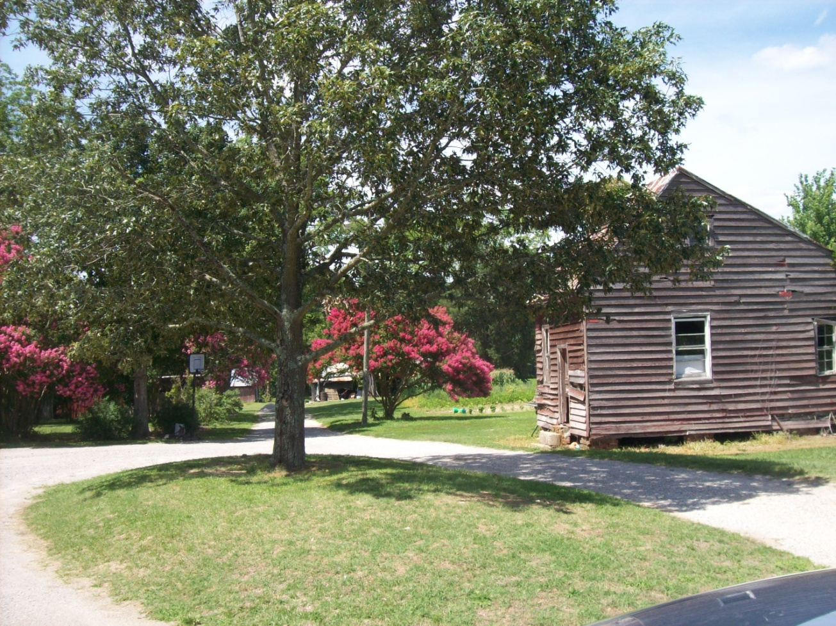
Earliest Holliman House standing in Isle of Wight County, Virginia
Notes:
This is a pre-1830 home of the Hollemans who lived in Mill Swamp, Isle of Wight, Virginia. Here they resided as they built a Federal period home in 1830. The age of this cabin is not known.

Slide 31
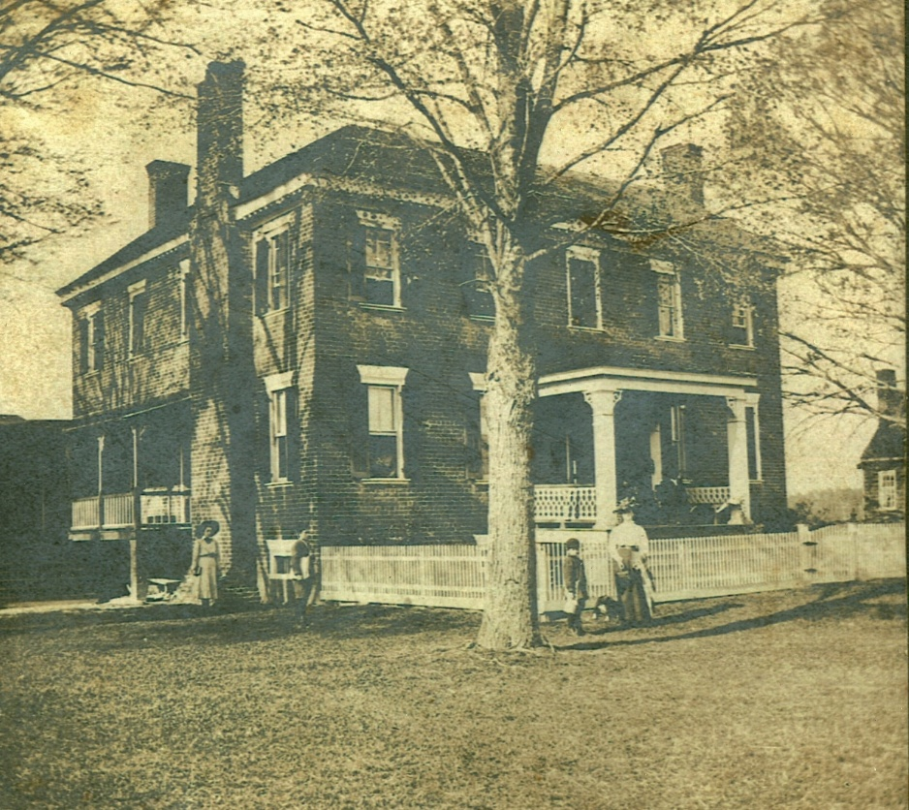
The Holleman House, Isle of Wight, Virginia in 1907 and 1921
Notes:
Note the difference in the 1907 and 1921 houses. On the far right of the earlier photograph can be seen a portion of the pre-1830 cabin.

Slide 32
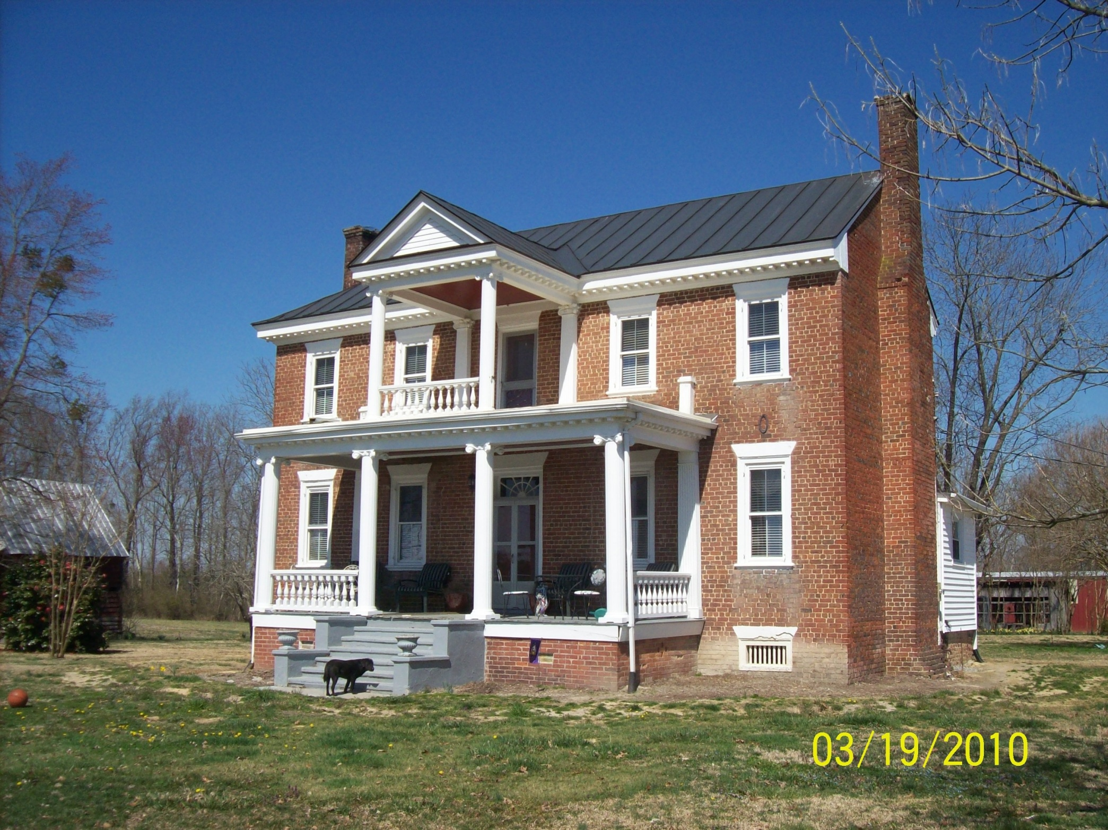
The 1830 Holleman House, Isle of Wight, Virginia
Notes:
Constructed in 1830 by Josiah Holleman. The front portico was added in the early 20th Century. Approximately 100 acres of the original plantation are still in the Holleman family. When Christopher Holyman died in 1691, the plantation was divided among his four sons.

Slide 33
1750 Settlement of America
Notes:
By the early 1740s, Samuel Holliman, the grandfather of the three Holliman brothers who would settle in Fayette County, Alabama in 1836, had moved to North Carolina from southeastern Virginia. His father, Richard Holyman, one of the four sons of Christopher Holyman, died in Surry County, Virginia in 1711. Samuel would die in North Carolina in 1789, born 1707 in Surry County.

Slide 34
The Westward Movement of the Hollimans and the Removal of the Southern Indians
Notes:
The pen and ink identifies the location this branch of the Holliman family as they moved from Virginia to Alabama in the years from 1650 to 1836. Diminishing the Creek nation was critical to the leap of the Hollimans and associated families from South Carolina to Alabama.

Slide 35
Additional Holliman Resources
Join the Hollyman Email List at Hollyman-Subscribe@yahoogroups.com .
Or the Hollyman Family Facebook Page located on Facebook at "Hollyman Family".
Post your questions and perhaps one of the dozens Holyman cousins on these sites may have an answer.
For more information contact Tina Peddie at desabla1@yahoo.com, the list and Facebook manager for Hollyman (and all our various spellings!).
Blog articles on Holliman (Holyman) family history can be found at http://hollimanfamilyhistory.blogspot.com/ and at http://ulyssholliman.blogspot.com/ .

Slide 36
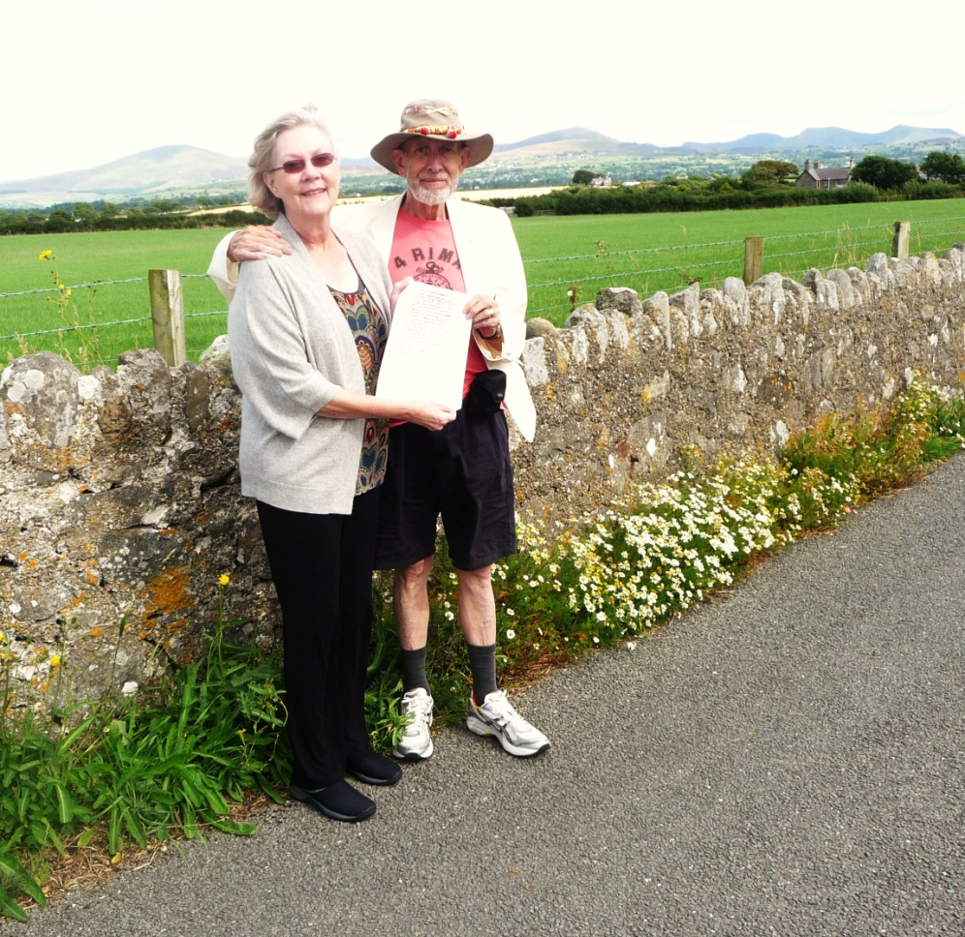
From the “Greenwood Tree”, a Somerset and Dorset magazine.
If you could see your ancestors
All standing in a row
Would you be proud of them, or not
Or do you really know?
Some strange discoveries are made
In climbing family trees
But some of them you'll find
Do not particularly please.
If you could see your ancestors
All standing in a row
There may be some, perhaps
You wouldn't care to know
But there's another question which
Requires a different view
If you could meet your ancestors
Would they be proud of you?
Twenty years ago one of my Hollyman relatives added: “Come to think of it they'd better be,
after all the time and thought we devote to them!” - Bob Hollyman-Mawson of Wales pictured with Jeanette Holiman Stewart in Wales, August 2013

