Slide 1
The Wilson and Greer Families of Western North Carolina
An Examination of Origins and Lineage
July 19, 2014
by Glenn N. Holliman
Photographs courtesy of Shirley Sorrell, Dale Wilson, Clinton Getzinger and other cousins.
glennhistory@gmail.com

Slide 2
The 19th Century Land of Wilsons and Greers (and other families)
Notes:
In yellow, are some of the locations where Boones, Wilcoxsons, Wilsons, Greers, Donnellys, Adams, Osbornes, Forresters and other associated families settled and where descendants live to this day. Ancestors came from England, Wales and Scotland, settling in Pennsylvania and the Chesapeake colonies before moving south and west in the middle 1700s. Their challenges were eastern colonial governments, Native Americans, the government of King George III, geography, weather and eventually during a vicious Civil War, their neighbors.

Slide 3
Caroline Greer and Isaac Wilson 1828-1911 and 1822-1864 Married 1848
Notes:
These are the great, great grandparents of Glenn N. Holliman, writer of this narrative. I begin here as these two individuals represent ancestors from Wilson, Adams, Wilcoxson, Boone, Greer, Smith, Morris, Brown and others. Their descendants would be Forresters, Osbornes, Graybeals, Donnellys and many more associated names. Offspring of this couple reside in to this day in the dramatic highlands of western North Carolina.

Slide 4
Isaac Wilson 1822-1864 Successful businessman and farmer; served in the Civil War first as a lieutenant with the 37th NC Confederate Regiment and then as an officer with Ashe County’s Confederate Home Guard. Killed from ambush by his Union neighbors while plowing corn with three of his children. Father of seven children.

Slide 5
Wilson Family Origins?
The Wilson lineage is not well researched.
We know that in the contact period of the Western North Carolina frontier, the 1750s, a Charles Wilson, settled in Rowan County, North Carolina. He was probably from Pennsylvania with possible ancestors from New England.

Slide 6
The American Frontier 1763
Notes:
That ‘ink blot’ of purple in western North Carolina demonstrates how far advanced on the frontier were our ancestors in the early second half of the 18th Century.

Slide 7
George Washington (1844-1827) and Frances Wilson Osborne (1851-1940), a daughter of Isaac and Caroline Greer Wilson
Frankie’s story - “Hiram Wilson was a son of John Wilson and John was a son of Charles, he come over in Mayflower from Ireland. My father was Isaac, the Son of Hiram.” - Frankie W. Osborne 1928
Notes:
In my great great grandmother’s diary, she wrote this narrative. Charles, John and Isaac ancestors are accurate. The Mayflower, well, quiet a stretch unless the Wilsons descend from New England, and some Ancestry sites make that claim. Work to be done.

Slide 8
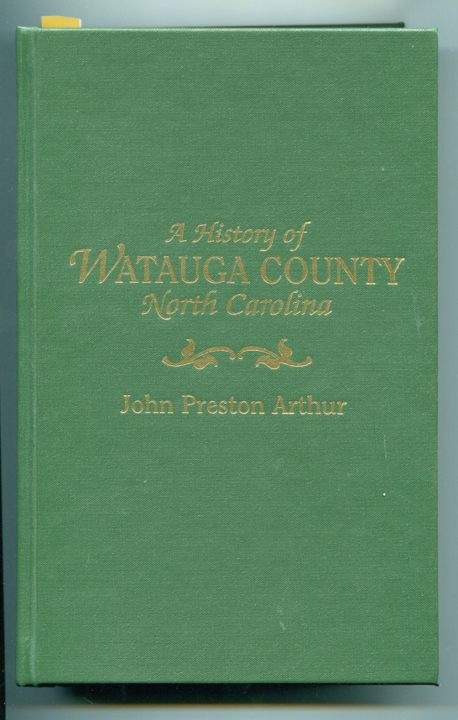
John Preston Arthur Thesis of 1915
Charles Wilson, (ca 1733-1781) father of
John Wilson, (1750-1812) father of
Hiram Wilson, Sr. (1778-1870 )father of
Isaac Wilson (1828-1864)
Notes:
A noted local historian wrote of the Wilsons in his 1915 work which has been reprinted.

Slide 9
Charles Wilson 1733-1781
Ancestry.com sites state he was born in Providence, Rhode Island and lived in Rowan County, NC by 1755. Perhaps.
John Preston Author states his wife was Rebecca Greene Wilson, alleged sister of General Nathan Greene. This seems dubious.
Charles did die as result of wounds at Battle of Guilford Courthouse, NC
Notes:
My research fails to turn up information that the great General Nathanial Greene had siblings. Sadly. Charles did die of his battle wounds. Osborne and Greers were very active as patriots during the American Revolution fighting Tories, British and Native Americans.

Slide 10
John Wilson 1750-1812
Ancestry.com sites and Frankie Wilson Osborne state John was son of Charles and father of Hiram Wilson, Sr. (among others)
Wife, Sara, unknown maiden name.

Slide 11
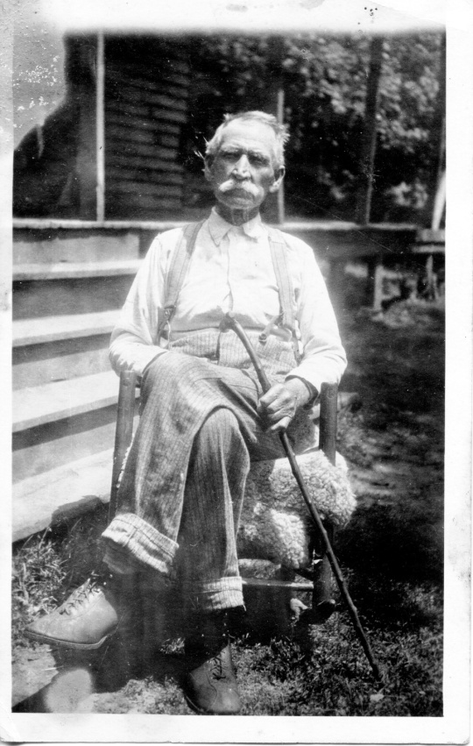
Hiram Wilson, Sr. 1778-1870
Married Nancy Smith (1793-1859)
Lost three sons to Civil War – Hiram Jr., William C. and Isaac, all Confederates.
Another son, Civil War veteran Albert Wilson lived until 1930, age 103. Photo below. He was in Picket’s Charge at Gettysburg.

Slide 12
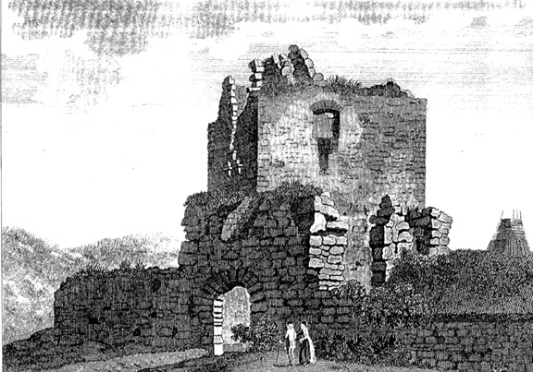
We are Greers Also! Below, the 15th Century remains of the Lag Tower near Dumfries, Scotland, home of the Griersons, a McGregor Clan family
Notes:
Sir James Grier, Sr., b 1604, d 1666 lived here, and married Mary Brown, daughter of a Presbyterian pastor at Glencain. James Sr. was descended from the Maxwell family. Both families were Scottish nobles and fought in the constant border wars amongst themselves and the English. The Maxwell’s are this writer’s 10th great grandparents, and Winston Churchill’s 9th great grandparents. Good to know! The color photo is from 2010, the writer’s wife, and the black and white from the 1770s.

Slide 13
The Griersons and Maxwells of Scotland Below the present Maxwell House at Glencarin, near Dumfries in southwestern Scotland near the Borders
Notes:
The Maxwells were descended from Stuart kings of Scotland.

Slide 14
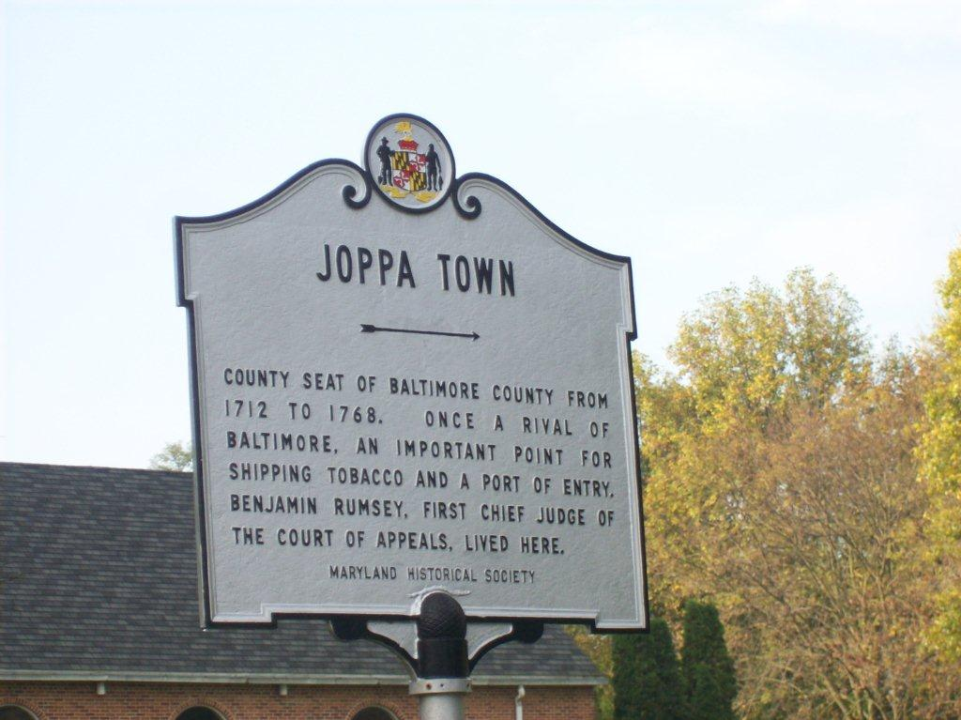
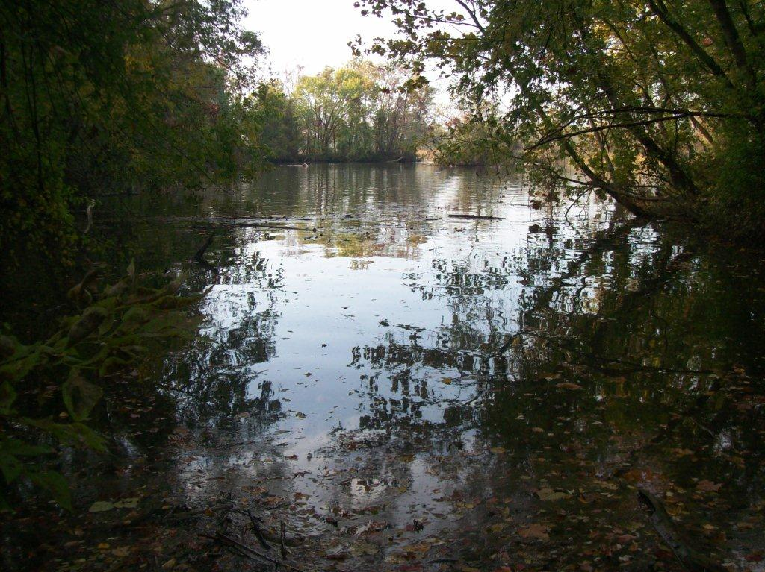
The Move to Maryland
James Greer, 1627-1688, migrated to Maryland, m. Anne Taylor (b 1660), and settled along the Gunpowder River in Joppa, Maryland. For generations a ‘ghost’ town; now a development off I – 95.
Notes:
At one time, before Baltimore was founded, Joppa, Maryland was a major port on the Eastern seaboard for several generations of our branch of the Greers lived along the Gunpowder River. Considerable research on the Greers is available on the web, a major Eastern family. Our branch would move south to the frontier of western North Carolina by the middle 1700s.

Slide 15
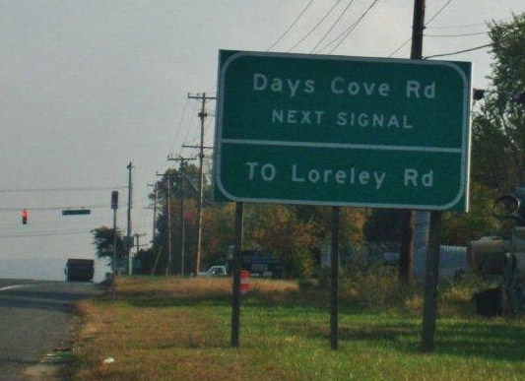
The Colonial Period
James’ son – John Greer, Sr. 1688-1752, the husband of Sarah Day
Later with a second wife, Chole Jones, John, Sr. migrated to Onslow County, NC along the Neuse River.
Notes:
The Day family was prominent in old Joppa, Maryland. A cove is named after this branch of our ancestors. Nicholas Day arrived as an indentured servant, a Welsh man, around 1658. The American dream – he died a wealthy man.

Slide 16
The Frontier Period
The son of John Greer, Sr., John Greer, Jr. (1714-1782), moved further west to Wilkes County, NC around 1771.
Served as justice of the peace and bequeathed his second wife, Nancy Lowe Walker, 600 acres.
First wife was Sarah Day Elliott, mother of Benjamin Greer.
Notes:
John Greer, Sr’s. will is the first one on file in our direct branch to list an African-American slave.

Slide 17
The Revolutionary Period
Benjamin Greer (1742-18 ), a larger than life ancestor.
First wife was Nancy Wilcoxson, (1743-1790) daughter of John and Nancy Boone Wilcoxson.
Nancy Boone, dau. of Squire and Sarah Morgan Boone, born Quaker in Penn. Youngest brother was Daniel Boone.

Slide 18
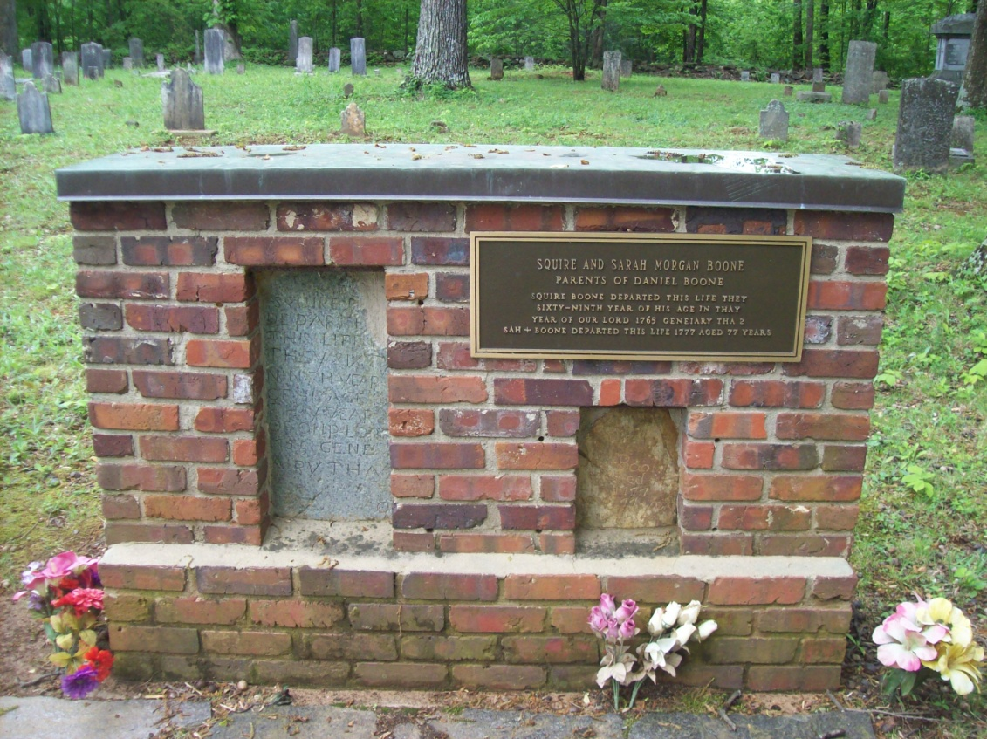
The Boone Graves in Mocksville, NC
Notes:
The graves of Squire and Sarah Morgan Boone are only one mile from I-40. The John Wilcoxson home from the late 1700s still stands, privately owned.

Slide 19
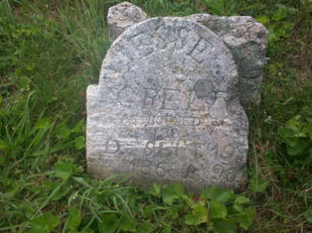
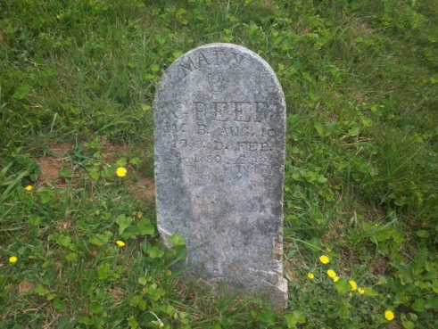
The Federal Period
Benjamin Greer had 15 children, one being Jesse Greer, Sr. (1778-1869) who ran away from home at age 16.
Eloped with 13 yr. old Mary Polly Morris, Wilkes Co., NC in 1800. Had 17 children!
Notes:
Jesse Greer, Sr. experienced a ‘great awakening’ in 1815 and joined the Baptist Church his father had left a decade earlier. As he wrote ‘the gall of bitterness was swept away.” Their graves are in Todd, Ashe County, NC.

Slide 20
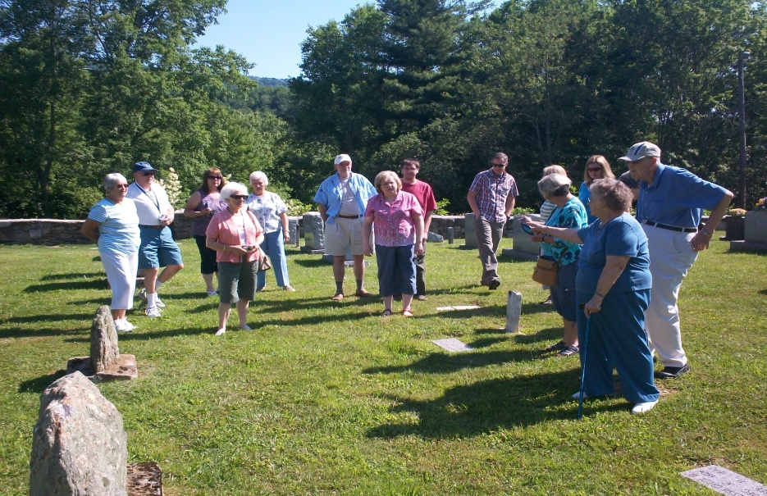
Frontier to Settlement to Civil War
One of the many children of Jesse and Polly Greer was Jesse Greer, Jr. (1806-1892).
Married Frances Brown (1810-1905).
Both Jesse and Frankie rush to assist Caroline Greer Wilson after the brutal shooting of Isaac Wilson in 1864.
Frances Brown Greer confronted Union soldiers stealing her ‘honey pot’.
Notes:
As of yet, I have found no photos of Jesse Greer, Jr. and Frances Brown. They are buried in the Presbyterian in Banner Elk, NC. July 2012, Annie Greer Heaton, a descendant, led other descendants to their graves.

Slide 21
Caroline Greer Wilson 1828-1911 Died of complications of broken hip. Buried in Wilson Cemetery, Sutherland, NC.

Slide 22
The Surviving Children of Isaac and Caroline Greer Wilson, Sutherland, NC 1918 Reunion
Notes:
Left to right, back, row are John Wilson, William Albert Wilson and Robert Boyd Wilson. Seat, left to right are Polly Jane Wilson Proffitt, Nancy Emaline Wilson Osborne and Frances Caroline Wilson Osborne. Deceased were Margaret Wilson and

Slide 23
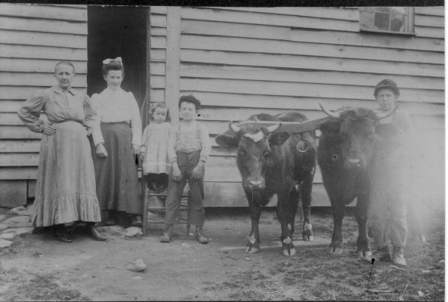
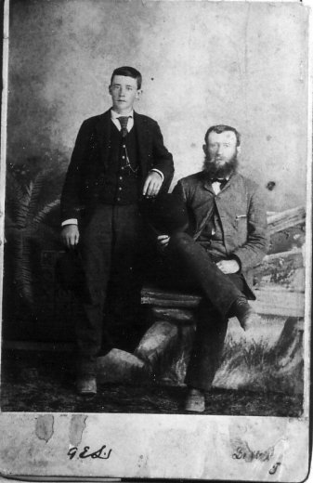
The Children of Isaac and Caroline Greer Wilson
Nancy Emaline Wilson Osborne (1850-1919) m. Richard Franklin Osborne (1846-1897). Twelve children. D. Ashe County, NC.
Notes:
Left photo – France Wilson Osborne and her sister Nancy Emaline Osborne with children. Right photo is Richard Franklin Osborne, sitting, with one of his sons.

Slide 24
Frances Wilson Osborne (1851-1940) m. G.W. Osborne (1862-1927) D. Bristol, TN. Below ca 1898 G.W. and Frankie with Toby, Pearl, Leroy, Bill, Bascom and Mayme (the baby).

Slide 25
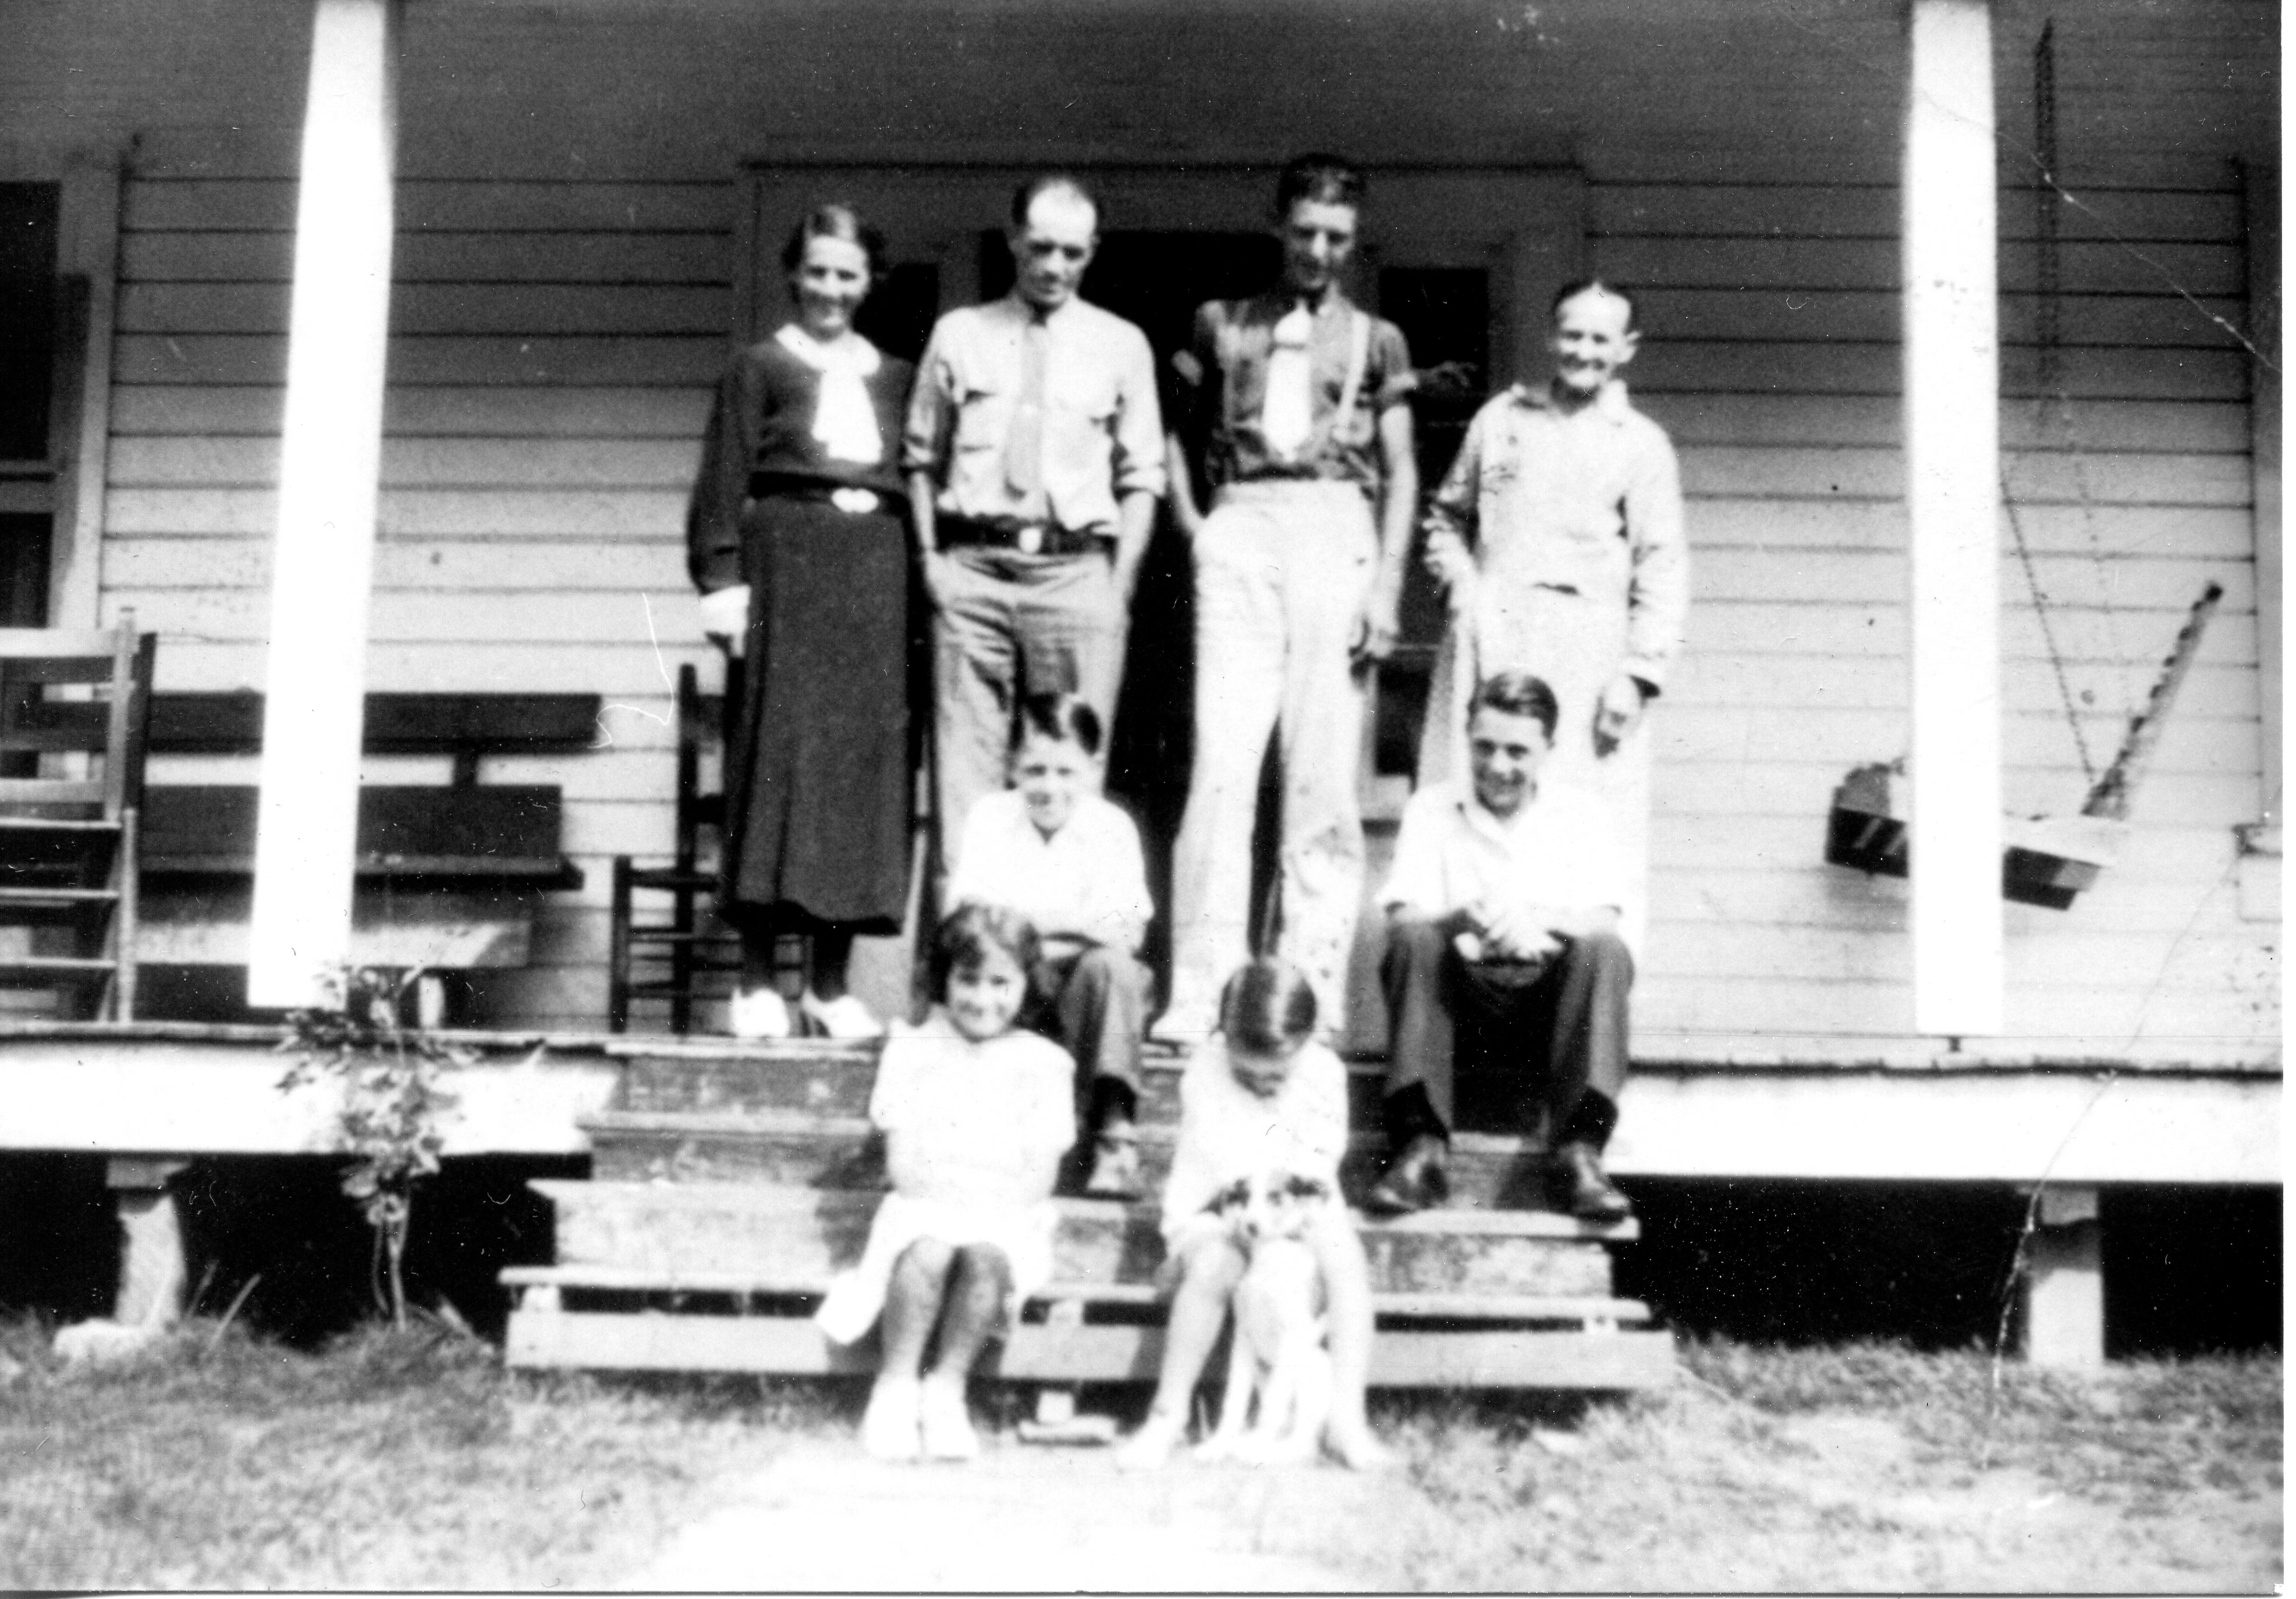
The Children continued
Polly Jane Wilson Proffitt (1852-1937) m. James Harvey Proffitt. Lived in Cove Creek.
Notes:
Above, undated, Jane Proffitt with her family.

Slide 26
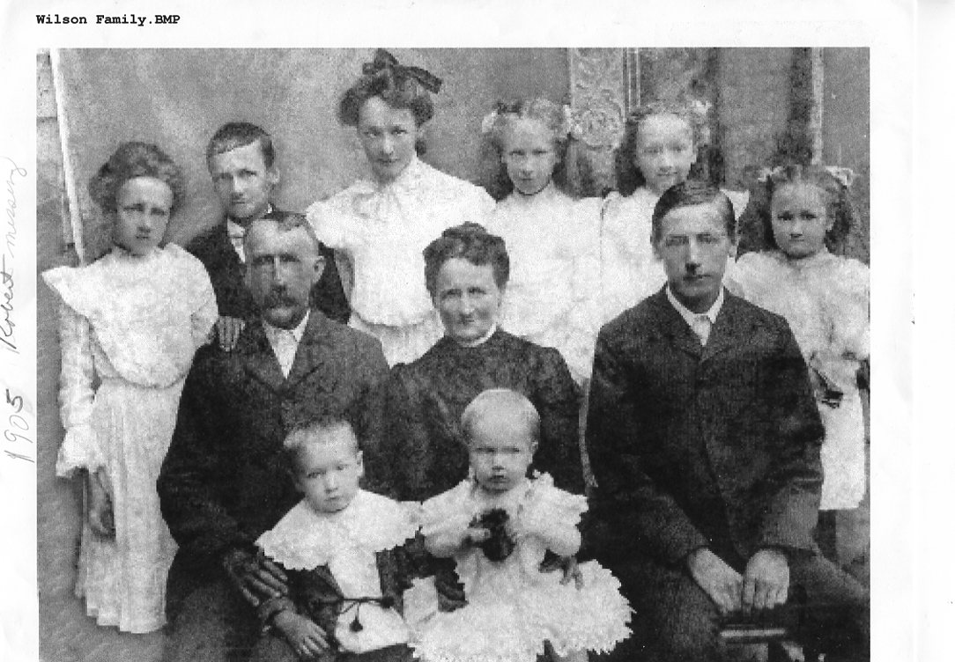
Children continued
John Wilson (1855-1928). M. Rebecca Wilson Wilson (1862-1952). B. Sutherland, Ashe Co., NC

Slide 27
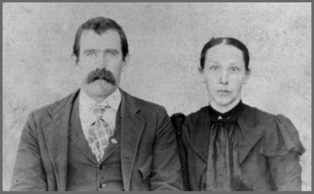
Children continued
Martha Evaline Forrester (1857-1904), m. Andrew Johnson Forrester and had five children.
Also, Had five children in 1870s by her brother in law, Franklin Richard Osborne.

Slide 28
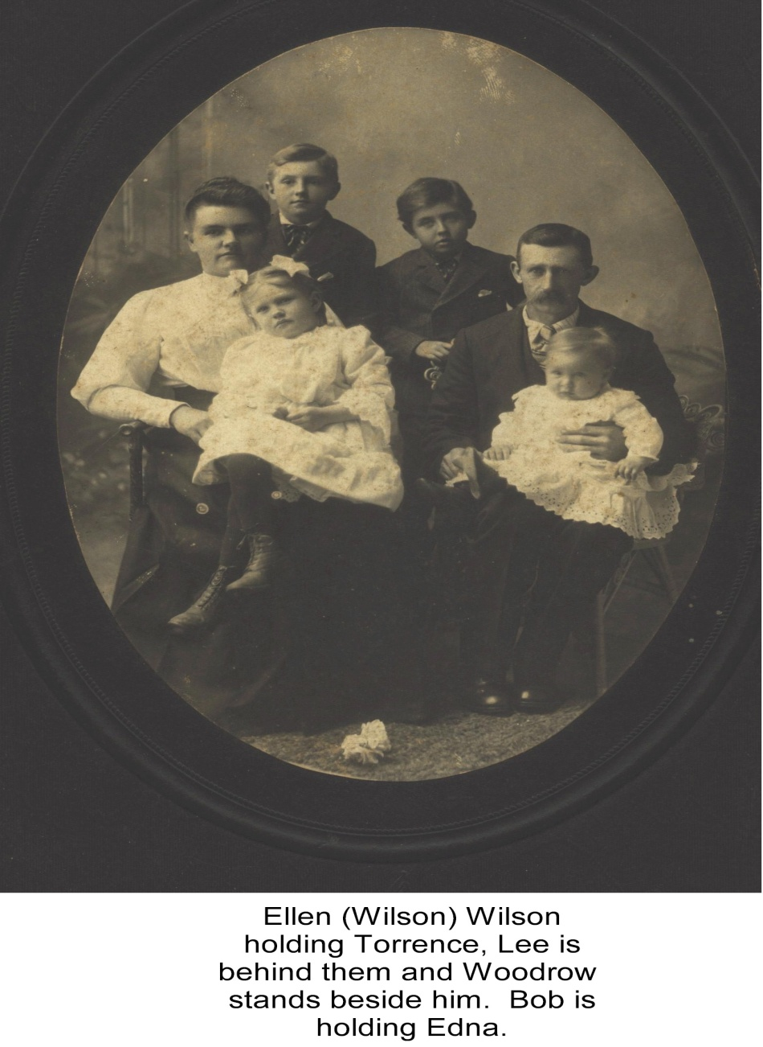
Children contined
Robert Boyd Wilson (1860-1949). M. Sara Ellen Wilson Wilson, sister of Rebecca Wilson (1866-1952)

Slide 29
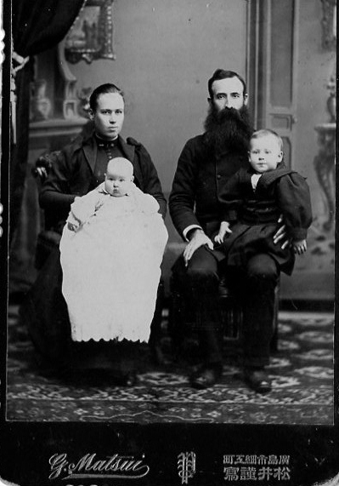
Children continued
William Albert Wilson (1861-1951), m. Mary Amelia McClellan. D. Raleigh, NC after 40 years Methodist
Missionary to Japan.

Slide 30
Children continued
Sara Marilla Wilson Osborne
(1866-1882), m. William Osborne,
no children

Slide 31
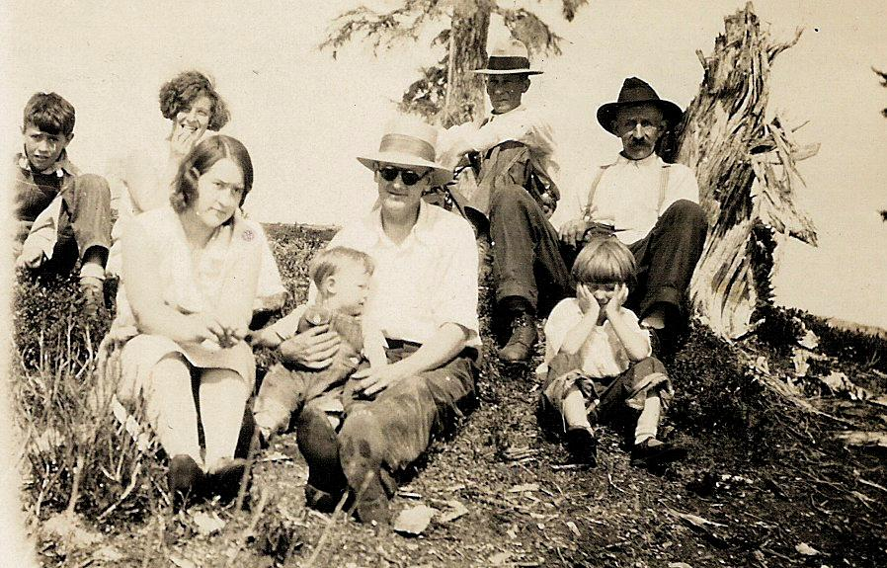
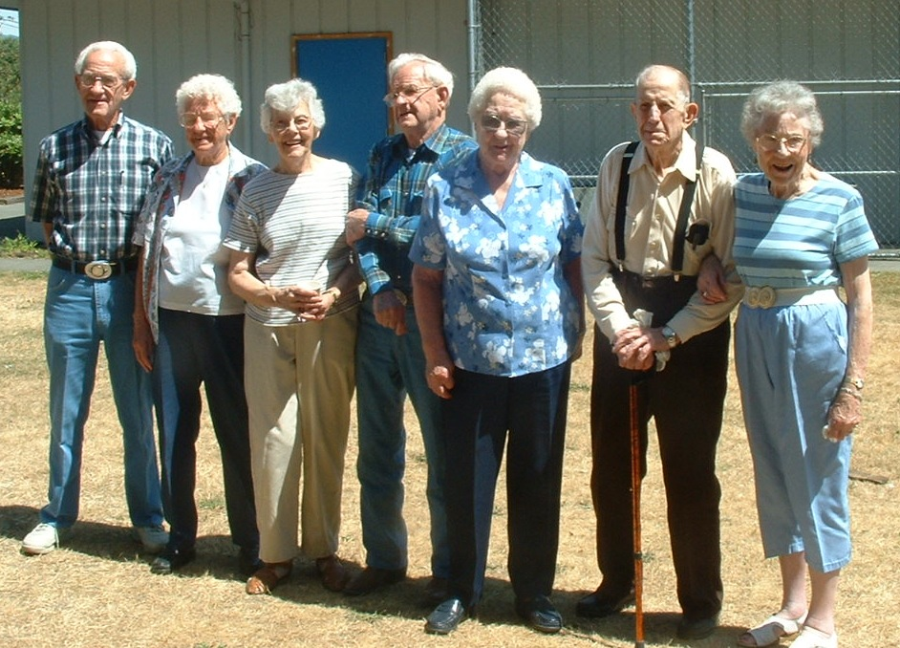
Many moved west!
Notes:
By 1914, ad from Boone, NC newspaper, many had taken the train west as the mountainous terrain and high birth rate could not support the many offspring of the Wilson, Greers, Osborne and other associated families. These photos are of Osborne descendants in Washington State couretesy of Jeannie Bond. “The black and white photo was taken about 1930 in Skagit County, Washington State. L to R in back: Cecil Mark Osborne (son of William I. Osborne) Beulah Martin, Charlie Martin, William I. Osborne (grandson of Lt. Isaac Osborne, son of Nancy Emmaline Wilson Osborne).
L to R in Front: Helen M. Osborne Anderson (daughter of William I. Osborne), V. Duane Anderson (son of Helen) Vernon Anderson (husband of Helen), Juanita K. Osborne (daughter of William I. Osborne)
The Martins were friends of the Osbornes and former residents of Ashe Co. North Carolina, as was W.I. Osborne
And the color photo was taken about 2000 at one of the Osborne Family Reunions held in Sedro Woolley, WA, the third Saturday of July since 1969.
L to R: C. Mark Osborne (B: 1919); Juanita K. Osborne Doran Wilson (1917-2009); Betty Alice Doran Osborne (wife of Derward); Derward H. Osborne (B:1916); Helen M. Osborne Anderson Pocock (1912-2014); Claude Pocock (husband of Helen); Clara Jane Pocock Osborne (widow of Chester C. Osborne)
Note: C. Mark, Juanita, Derward, Helen, and Chester C. Osborne are children of William I. Osborne who was the son of Nancy Emmaline Wilson and Richard Franklin Osborne.
All of William's children were born in Skagit County, WA.” – Jeanie Bond

Slide 32
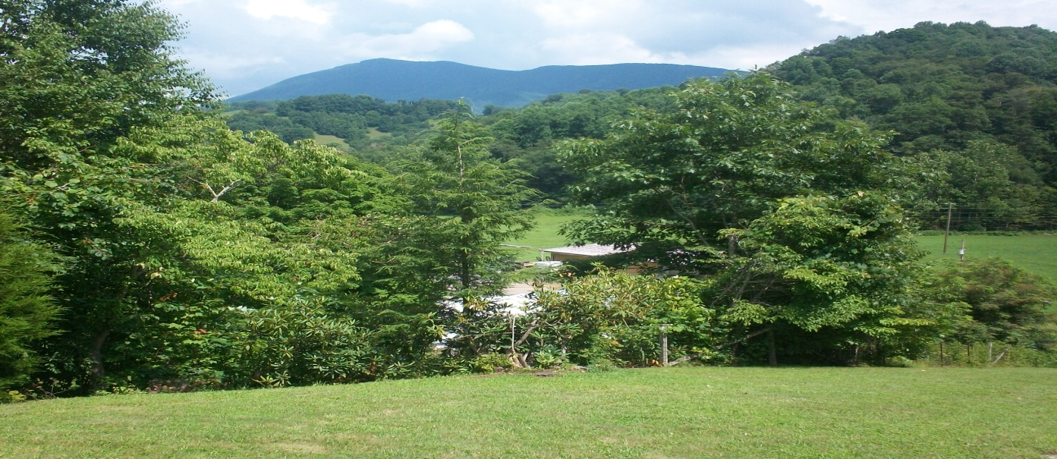
The Journey Continues
Today, while many descendants of these pioneer families still reside in western North Carolina, we now live all over the United States, heirs to a grand and very human legacy.
Notes:
A scene of Ashe County, NC looking toward a 5,000 foot peak from the front yard of Shirley Sorrell, whose ancestors have lived on the land for over 200 years.

Slide 33
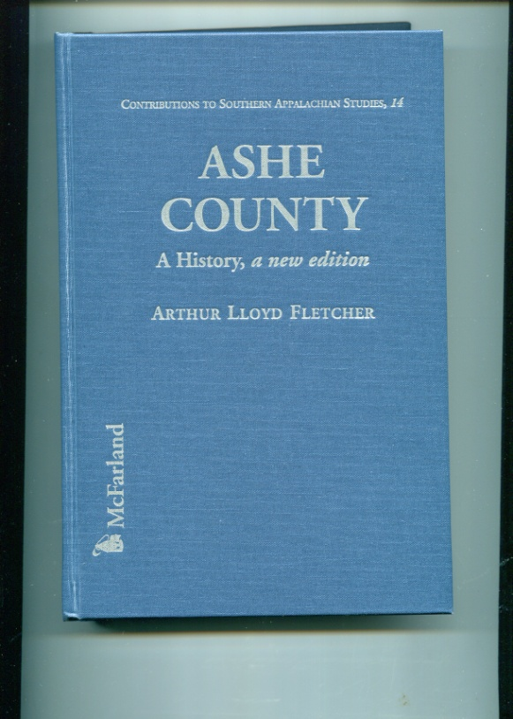
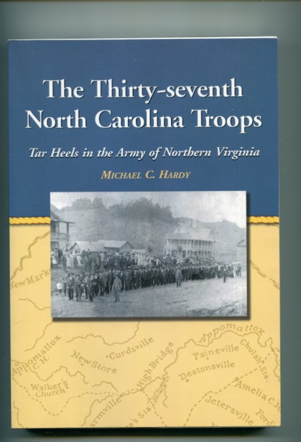
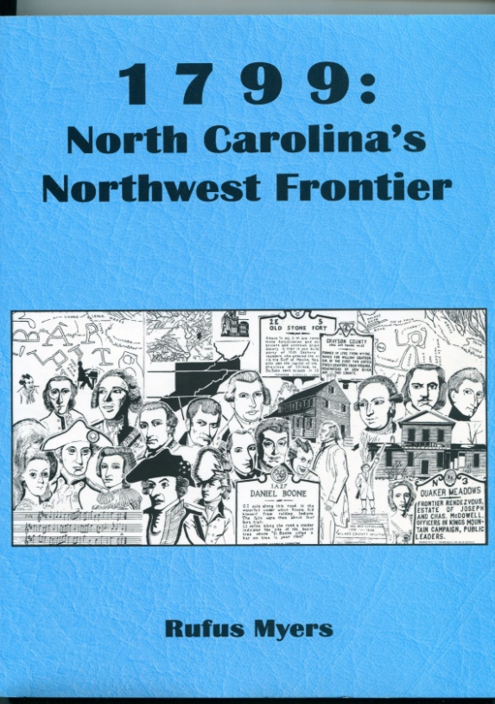
For More Information
Notes:
There is considerable literature on Ashe County, NC with the names and stories of many family members.

Slide 34
Books by Family Members
Notes:
William A. Wilson’s notes on the bushwhacking of his father in 1864 and much more has been published by Appalachian State Univerisy. Dedicated family researcher and descendant, Clinton W. Getzinger, has written a novel with material drawn from family experiences. Both can be found at Amazon.com.

Slide 35
For More Information
Help create a virtual archives for future generations.
To contribute materials or photographs, contact Glenn N. Holliman (GGGS of Isaac and Caroline Greer Wilson) to participate in a dedicated Drop Box for Wilson/Greer/Osborne and Associated Families.

Slide 36
Ancestry.com site
A dedicated Wilson/Greer/Osborne/Forrester/Stansbery and Associated Families Ancestry.com site is available.
To join write Glenn N. Holliman at Glennhistory.com and help add to a Family Tree that grows weekly.

Slide 37
http://fwosborne.blogspot.com/

Slide 38
For Yet More Information
Subscribe to http://fwosborne.blogspot.com/ for regular postings of Wilson, Greer, Osborne, Stansbery and many more associated families.
Administrators, generally younger than this writer, are needed to hold passwords and pass along information to future generations!

